Slide 1

Pawsitive Panthers

Slide 2

Kindergarten - Ransen
Bryce Johnson

Slide 3

Kindergarten - Leuthold
Serenity Wentz

Slide 4

Kindergarten - Batenhorst
Olivia Elliott

Slide 5

First Grade - Kerkman
Kaden Clark

Slide 6

First Grade - Garder
Whitney Merkel

Slide 7
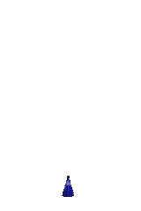
First Grade - Walker
Cooper Galyen

Slide 8

Second Grade - Jenkins
Kenly Muehlmeier

Slide 9

Second Grade - Johnson
Amelia Wragge

Slide 10

Second Grade - Myers
Decklin Gangwer

Slide 11

Third Grade - Haglund
Hudson Bulau

Slide 12

Third Grade - Lewis
Maverick Planer

Slide 13

Third Grade - Mora
Evan Mortimer

Slide 14

Fourth Grade - Burkink
Jocelyn Kuehner

Slide 15

Fourth Grade - Kalin
Jada Petzold

Slide 16

Fourth Grade - Schick
Jenna Probasco

Slide 17
Thank you for making “Paw-sitive” Choices!!!

